Slide 1

Senior Design Project Signal Block Layout Tool
Team Members:
Kenneth Truex
Zachary McHenry
Chad Mason
Chris Diebold
Dan Ballesty
Curtis Mechling
Roger French
Mark Schwinghammer
October 24, 2014
Chris

Slide 2
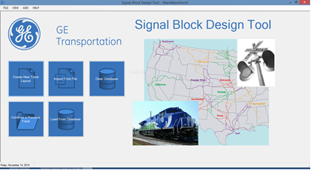
Signal Block Layout Tool
Project Scope
Project Scope
Calculate Safe Braking Distance
Lightweight Desktop Application
Inputs & Parses a Comma Separated File
Stores Track and Train profiles, and Analyzes Results for long term use
Provides notification of a potentially unsafe block and train combination
Utilizes a User Friendly GUI
Chris

Slide 3



Signal Block Layout Tool
Technologies
Technologies Utilized
Target Technologies
Programming Language: C# – Provided a rich selection of libraries and integrates well with other languages.
IDE: Visual Studio 2013 – Industry standard for developing a C# applications
Database: MySQL – Familiarity with a technology is invaluable and allows for safer development
Target hardware: Windows 7+ machine – specifically a machine that has .NET framework 4.5 and the OpenTK framework installed.
Operational Technologies
Webex – Used to communicate with team members located outside of Melbourne or on occasions of absence.
Git – Version control used to allow teammates to work independently but allow for cohesive development.
Chad

Slide 4


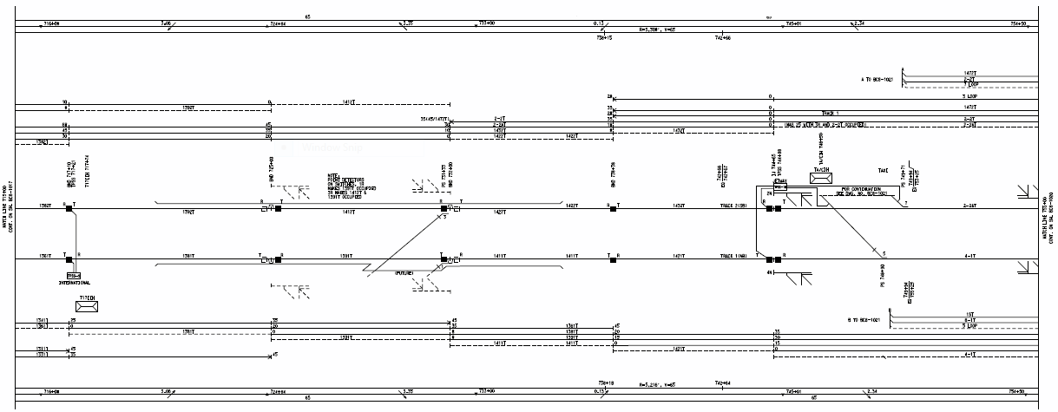
Signal Block Layout Tool
Lessons Learned
Challenges & Lessons Learned
GE
Better Project Planning
Improved Project Scope/Definition
FIT
Think modularly
Software development is no easy task
Compromise
Communication is key
Zack

Slide 5
Signal Block Layout Tool
Lessons Learned
SBD Algorithm Explained
A set of instructions to recreate what
used to be done in the excel spreadsheet
Precision was the key element
Had to combat rounding errors
Ken

Slide 6
Signal Block Layout Tool
SBD Algorithm
public static double SafeBrakingDistanceCalculations(TrackSegment obj)
{
double availStopDist = Math.Abs(obj.TargetLocation - obj.brakeLocation);
double overspeedTotal = obj.OverSpeed + obj.SpeedMax;
double velocityFinal = (obj.VehicleAccel * 1.2) + overspeedTotal;
double reactionDist = obj.ReactionTime * overspeedTotal * 1.467;
double negGradeAdjBrakeDist = 0.733 * velocityFinal * velocityFinal / (obj.BrakeRate + (0.219 * obj.GradeWorst));
double posGradeAdjBrakeDist = 0.733 * velocityFinal * velocityFinal / (obj.BrakeRate - (0.219 * obj.GradeWorst));
double runwayAccelFt = 1.467 * (0.5 * obj.VehicleAccel * obj.RunwayAccelSec + overspeedTotal) * obj.RunwayAccelSec;
double propulsionRemFt = velocityFinal * 1.467 * obj.PropulsionRemSec;
double brakeBuildUpFt = velocityFinal * 1.467 * obj.BrakeBuildUpSec;
double SBD = Math.Round(reactionDist + runwayAccelFt + propulsionRemFt + brakeBuildUpFt + negGradeAdjBrakeDist + obj.OverhangDist, 1);
bool isSafe = SBD < availStopDist;
if (!isSafe) { obj.IsSafe = false; }
else { obj.IsSafe = true; }
obj.SafeBreakingDistanceRequired = availStopDist;
return SBD;

Slide 7
Signal Block Layout Tool
Lessons Learned
Software Engineering
Demo Time!
Ken

